Slide 1

Asynchronous Programming in Visual Basic .NET

Slide 2
Asynchronous? Synchronous?
Method Calls
  Public, Private; Sub, Function
Synchronous
  Calling code waits for function before continuing
Asynchronous
  Calling code moves immediately to next line
  Method executes on another thread
  Method calls a local method (Callback) when completed
Use to increase the responsiveness of your application
  Calling a web service, for example

Slide 3
Asynchronous Web Services
Begin/End methods
  i.e. BeginHelloWorld and EndHelloWorld
Create a Callback function
  Private Sub CallBack(ar As IAsyncResult)
Call BeginHelloWorld. Pass Addressof Callback
  MyService.BeginHelloWorld(AddressOf CallBack)
Web Service is called on a new thread from the system thread pool
Callback is called when data is returned
Get the value from EndHelloWorld. Pass ar variable
  Dim Result As String = MyService.EndHelloWorld(ar)
Callback is not running on Main Thread!

Slide 4
Asynchronous Web Services
Demo!

Slide 5
Threads
Thread Defined
  A sequence of instructions
  A single sequential flow of control within a program
  Has a beginning and an end
  Processor multitasks between threads
    Just as it does between applications

Slide 6
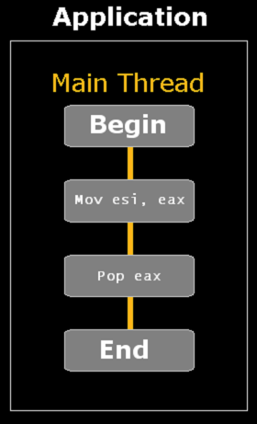
Threads

Slide 7
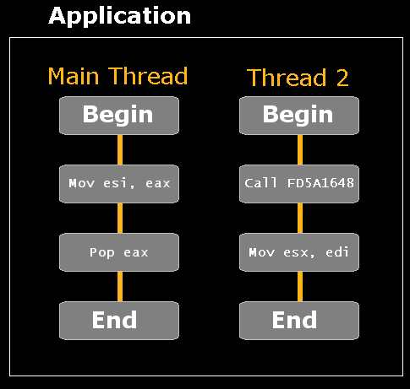
Threads

Slide 8
Create a New Thread
  Imports System.Threading
  Private Sub StartThread()
  Dim T As New Thread(AddressOf ShowTime)
  T.Start()
  End Sub
  Private Sub ShowTime()
  '-- Go to sleep for 5 seconds
  System.Threading.Thread.Sleep(5000)
  MsgBox(Now)
  End Sub

Slide 9
Thread Pools
ThreadPool Object
  Use when you need to manage multiple threads
  Lets you add method calls to a queue
  Allows only 25 threads to execute (default)
  Imports System.Threading
  Private Sub StartThread()
  Dim WCB As New WaitCallBack(AddressOf Foo)
  ThreadPool.QueueUserWorkItem(WCB)
  End Sub
  Public Function Foo
  '-- Do Something that takes a long time here
  End Sub

Slide 10
Create a New Thread
Demo!

Slide 11
Thread Synchronization
Module Level Variables
  Shared by all threads executing the method
  Threads execute independently
  Private MyNumber As Integer
  Private Sub IncrementMyNumber()
  '-- If executed by two or more threads,
  ' this may cause a problem!
  MyNumber = MyNumber + 1
  End Sub

Slide 12
Synchronization
The order of execution of two or more threads determines what happens.
  This is called a Race Condition
    Private MyNumber As Integer
    Private Sub IncrementAndPrintNumber()
    MyNumber = MyNumber + 1
    ‘-- Another thread also increments MyNumber HERE!
    Console.WriteLine(MyNumber)
    ‘-- Now the number has been incremented twice
    End Sub

Slide 13
Automatic Synchronization
Create a Thread-Safe class
  Synchronization attribute
    Assures only one thread can access at one time.
  Imports System.Runtime.Remoting.Contexts
  <Synchronization()> Public Class Foo ()
  Private Sub IncrementNumber()
  MyNumber = MyNumber + 1
  End Sub
  End Class

Slide 14
Manual Synchronization
Lock the thread while modifying module-level variables
  Manual Method: Use SyncLock keyword
  Lock object must be a reference type
  Private MyNumber As Integer
  Private LockObject As New Object()
  Private Sub IncrementAndPrintNumber()
  SyncLock LockObject
  MyNumber = MyNumber + 1
  Console.WriteLine(MyNumber)
  End SyncLock
  End Sub

Slide 15
Manual Synchronization
Other manual synchronization methods:
  Mutex
    Used for interprocess synchronization
  Monitor
    Use for blocks of code that need to be synchronized
    SyncLock simplifies Monitor access
  ReaderWriterLock
    Modify the variable in one place
    Read the variable in many places

Slide 16
Accessing Numeric Value Types
Interlocked Class
  Lets you compare, replace, set, increment, and decrement a numeric value used across threads.
  Private MyNumber As Integer
  Private Sub DoSomething()
  Interlocked.Increment(MyNumber)
  End Sub

Slide 17
Cross-Thread Communication
Synchronization Events
  Useful when managing multiple threads
  AutoResetEvent and ManualResetEvent
  Private ThreadStatus As New AutoResetEvent(False)
  Call Set() in a background thread when done processing
  ThreadStatus.Set()
  Call WaitOne() in a main thread to wait until processing is done
  ThreadStatus.WaitOne()

Slide 18
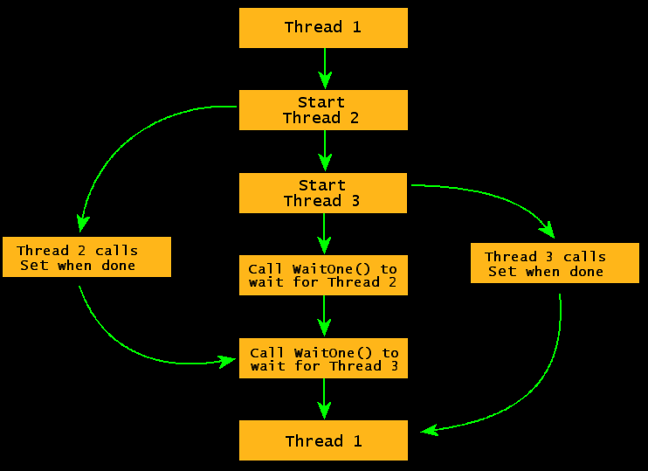
Cross-Thread Communication
AutoResetEvent
Usage Diagram

Slide 19
Cross-Thread Communication
Demo!

Slide 20
Threading Resources
My Favorite Threading Book:
  Visual Basic .NET Threading Handbook
  http://www.wrox.com/books/1861007132.htm
Online:
  Safe Thread Synchronization
  http://msdn.microsoft.com/msdnmag/issues/03/01/NET/
  .NET 247 Threading Guide
  http://www.dotnet247.com/247reference/guide/33.aspx

Slide 21
Windows Forms Issues
Windows Messages (i.e. WM_CLOSE)
  Can only be processed by the main thread
Problem:
  Modifying Windows Forms and Controls from any thread other than the main thread
Solution:
  Make all UI-modifying code on the main thread
  Synchronizing will not solve the problem
How?
  Invoke a Delegate from Callback using main thread

Slide 22
ISynchronizeInvoke
Windows.Forms.Control implements this.
Provides an Invoke method
  When called from any thread, thread context will shift from the calling code thread to the thread of the form or control
Controls that use multiple threads have a SynchronizingObject property

Slide 23
Sidebar - What is a Delegate?
Code Pointer
  AddressOf MySubroutine()
Data Type
  Private Delegate Sub dlgMySubroutine()
More Specifically
  Intermediary between the caller of an event, and the code that will handle the event

Slide 24
How to
Create a private sub that modifies UI
  Private Sub ModifyUI()
Create a Delegate for that sub
  Private Delegate Sub dlgUI()
From Callback, Create a delegate variable
  Dim dlg As New dlgUI(AddressOf ModifyUI)
Call Invoke from the Form, pass dlg
  Me.Invoke(dlg)

Slide 25
Complete Async Callback
Demo!

Slide 26
Wrap-up
Threading can be complex – read up!
Synchronization is required
Use thread pools when possible
Avoid granular SyncLocking
Use ReaderWriterLock for read-only objects
Use AutoResetEvent object when managing multiple threads
To avoid GDI problems, Call form’s Invoke method using a delegate from an asynchronous callback
Send .NET newbies to my VB.NET Master Class!

Slide 27
Questions?

